Slide 1
NAU Computing Cluster (MONSOON) with R!
Stella Copeland & Charlie Duso
NAZRUG, Dec. 2nd, 2016

Slide 2
What is a “cluster”, what is MONSOON, and why should I spend time trying to figure it out?
A cluster is basically a web of interconnected computers
Similar to multiple cores on a personal computer
MONSOON is NAU’s high performance computing cluster http://www.nau.edu/hpc - 884 Intel cores! 12 Nvidia Tesla K80 GPUs! 750 TB shared memory!
Access is available for NAU-based research use
Why use it with R (or other software)?
Do you run the same code on your computer over and over with slightly varying parameters?
Does it take a long time (hours)?
Does the computation demand more space than you have on your computer?
Notes:
First off – ask who is currently using MONSOON, who has used another cluster before?
Point out that everyone will need to sign up for an account, and have an NAU affiliation

Slide 3
How does MONSOON work?
Linux scheduling software (SLURM, Simple Linux Utility for Resource Management) links you to the network with your NAU credentials and manages all of the jobs submitted to the cluster
You must submit your ‘job’ parameters in a batch (.sh) script
Your results and code normally reside on your own private folder within the cluster’s storage

Slide 4
Setting up your cluster account
Take a short training and request an account (see http://www.nau.edu/hpc/monsoon-account-request-form/)
2. You may need to download software for file transfer (code, datasets, output) between your computer & MONSOON. Depends on operating system and maybe security settings. I ended up having to use WinSCP (https://winscp.net/eng/download.php). Linux has built-in utilities for this.
3. You can ‘push’ your output files directly to your Google Drive, or ‘pull’ them into MONSOON from there. This is useful if you are generating large files which might max out the temporary storage available per person on MONSOON, or take a long time to copy. Get an unlimited storage Google Drive account through NAU if you can!
Notes:
Don’t worry about the LINUX – I knew NOTHING when I started this a few months ago, and I was able to run code on the cluster within a couple of days.

Slide 5
Learning how to ‘think cluster’
Thinking through the items below will make your code run fast and start quickly on the cluster!
How can you parallelize the code / task?
Can it be split by some group (i.e. species, region)?
Can the internal code of the functions/packages take advantage of parallelization such as with ‘snow’?
How dependent are the steps of your analysis?
This is tricky, but how much time do you estimate the code will take?
What is the maximum amount of memory needed (also tricky)?
Notes:
MONSOON runs through a scheduling system. Your job will be slowed down or sped up by the use of the cluster by your account group, as well as by the overall demand on the cluster. However, you an control when your job runs by making it as flexible as possible, allowing the scheduler to say, “hey! I can find the resources for that!” faster rather than later, which is what happens if you are rigid about the requirements of your ‘job’ – and they are high in terms of memory, # of cores, etc.

Slide 6
Same functions over and over, but for different datasets, species, other categories?
This could be handled as a loop or a parallel process in R – on the cluster it could be an array!
For an array, you need to be able to specify the individual groups/iterations within the SLURM code and within your R code

Slide 7
Example – array batch script
#!/bin/bash
#SBATCH --job-name="PRISM_LTDL"
#SBATCH --time=4:00:00
#SBATCH --mem=240000
#SBATCH --error=PRISM_LTDLL_%a.txt #error output
#SBATCH --output=PRISM_LTDL_%a.out #maybe not necessary
#SBATCH --mail-type=END
#SBATCH --mail-user=scopeland@usgs.gov
#SBATCH --workdir=/scratch/smc679
#SBATCH --array=1-3 #this tells SLURM I have an array of 3 tasks
#module
module load R
#script
srun Rscript PRISMPolygonCluster_110116Array.R ${SLURM_ARRAY_TASK_ID}
#the above runs the script for each number, 1-3
cat PRISM_LTDL_%a.txt | mail -s "$SLURM_JOBID log" scopeland@usgs.gov #sends e-mail with job ID #sends me a message with the status

Slide 8
Example – array R script
library(raster); library(dismo);library(reshape2)
args <- commandArgs(TRUE) #R script tied to .sh array task number
poly.sp <- shapefile("Treatment_Polygons_Subset.shp") #a shapefile
Bio1 <- stack("Bio1_MnAnnualTemp");Bio2 <- stack("Bio2_MnDiurnalRange");
Bio3 <- stack("Bio3_Isothermality") #some rasters
Bio.list <- list(Bio1, Bio2, Bio3) #make a list of rasters for the array
#extracts the data for each polygon from the list of raster files
Bio.plys <- extract(Bio.list[[as.integer(args[1])]], poly.sp, df=T) #extracts 1-3 from list
Bio.plys.2 <- melt(Bio.plys, id.vars="ID"); Bio.plys.3 <- dcast(Bio.plys.2, ID~variable, mean)
Bio.plys.4 <- merge(poly.sp@data[, c("ID", "Prj_Name", "Trt_ID")], Bio.plys.3, by="ID", all.x = T)[,-1]
write.table(Bio.plys.4 , file = paste0("Bio", args[1], "_Plys", ".csv"), sep=",", col.names=T, row.names=F) #results in separate table for each raster in the list

Slide 9
Message Passing Interface (MPI)
An application achieves parallelism by running multiple copies of itself across different nodes
Each copy has a specific task that it processes and communicates with other copies
One master CPU, many slave CPUs
MPI allows for more flexibility and control over tasks
More complex than other parallel implementations, but potentially more powerful in terms of speed and control
Under optimal conditions, doubling CPUs should reduce time by half
More CPUs is not necessarily more speed, however, due to communication overhead
Improper setup can be detrimental
R has many MPI-based packages, Rmpi and Snow being the most popular.

Slide 10
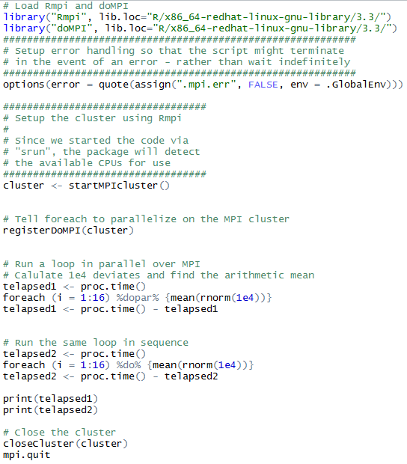
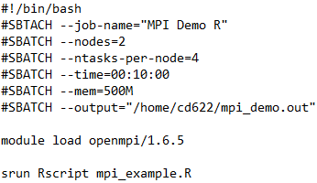
MPI Example - Setup

Slide 11

MPI Example - Results
MPI Example
Sequential Example
MPI is not always faster!

Slide 12
Some Monsoon with R tips and Ideas
Sometimes the version of a package may not be installed on the cluster – you can install it in your own working directory and require it within the script
There are a lot of commands within the MONSOON Linux scheduler (SLURM) that can tell you more about your job’s requirements/usage
It’s helpful to have your SLURM batch script email or save error messages!
Can’t tell you how many times my code has failed because of an error in my R code, rather than cluster issues!
Use the ‘testing’ line in your script for debugging if possible! Will run sooner!
#SBATCH --qos=debug
MONSOON folks are helpful if you run into problems!
Some packages will write your SLURM script for you within R, e.g. rslurm, but they don’t seem all that much easier than writing your own scripts…

Slide 13
Last but not least…
Working within the cluster will probably help you gain an appreciation for:
Slow-down issues in your code
Parallelization you can do on your computer within R for various functions / packages
The limitations of the ‘one computer’ approach!
And it will Change Your Coding Paradigm!
Notes:
At this point we can show an example – run the code through the various steps

Slide 14
Time for discussion and questions!
What cluster(s) are you working on?
What types of schedulers do they use?
Can you tell the group some tips and tricks that we can record here and now and send out?
Would you be interested in further meetings or e-mails on ‘clustering’ with R?

